Slide 1

Google Earth Engine
READing, DOWNLOADing, and PROCESSING IMAGES

Slide 2
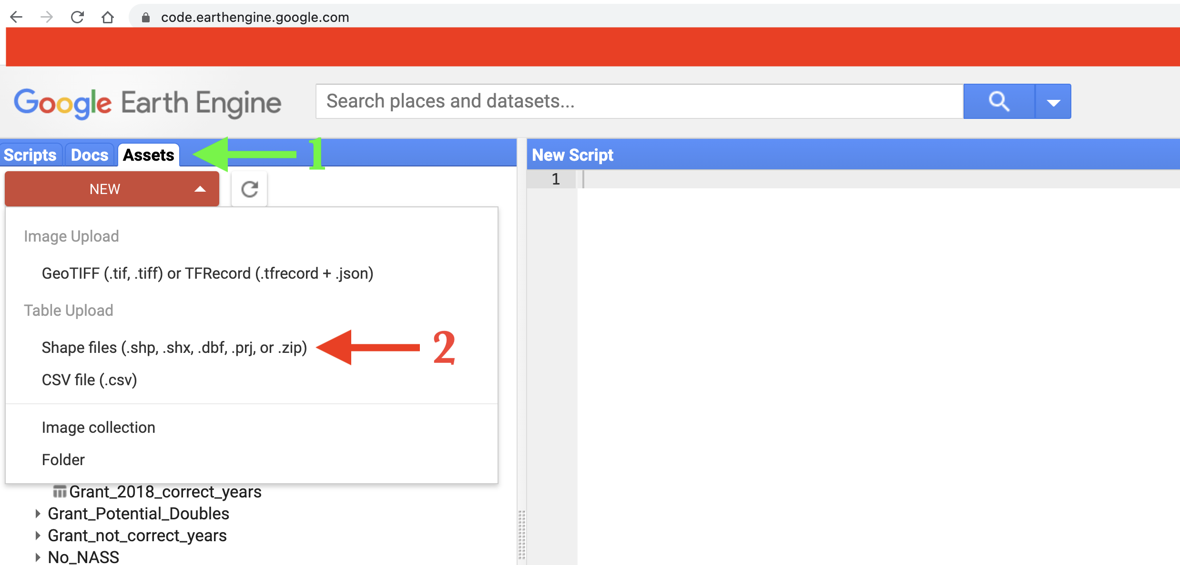
Upload a shapefile into GEE
A shapefile is created for you. Please download it from Google drive:
https://drive.google.com/drive/folders/1tVYJXTH04YjMXjLyJyN_-OuIJI4BE-HZ?usp=sharing
Log into your code editor: https://code.earthengine.google.com/
Choose Assets, then shape files, then navigate to your local directory: select all 4 files in the shapefile you downloaded previously, and upload them:

Slide 3
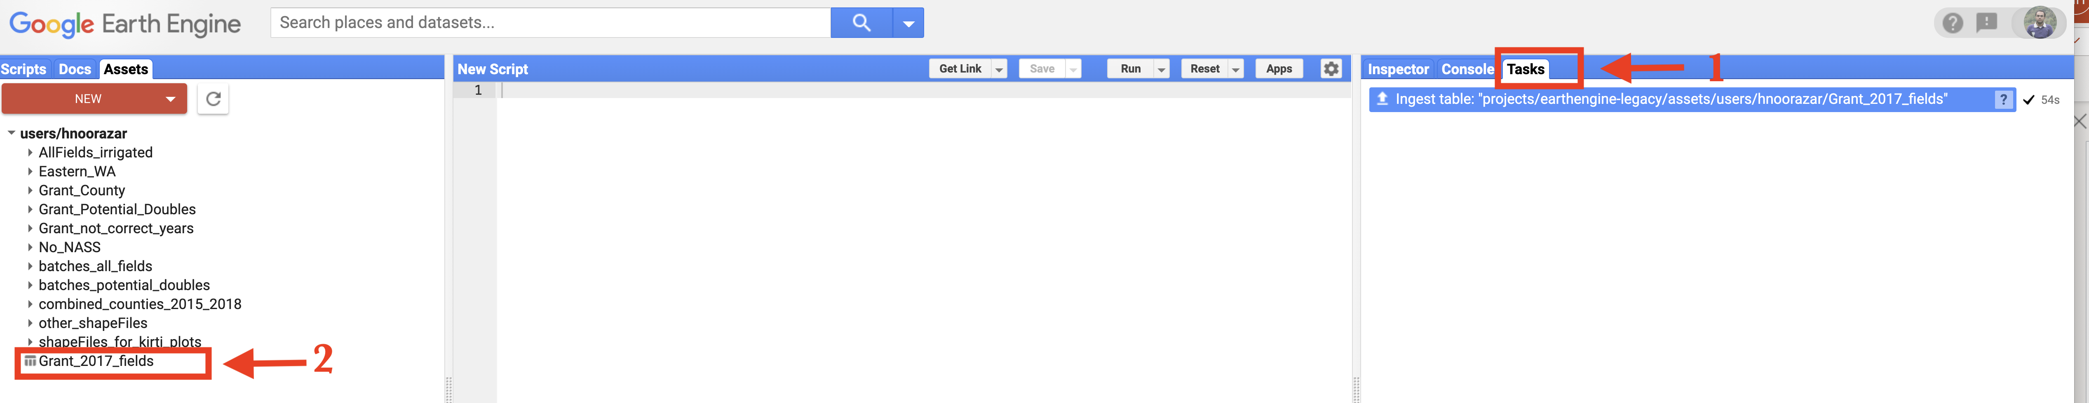
Uploading Process
Uploading the shapefile takes a few seconds/minutes depending on its size.
Track the process via Tasks Tab. You may need to click on Refresh button.
Once it is uploaded you can see it on your Assets tab

Slide 4
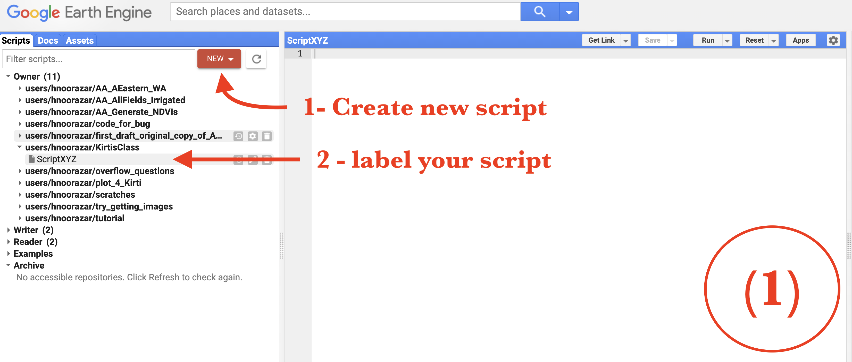
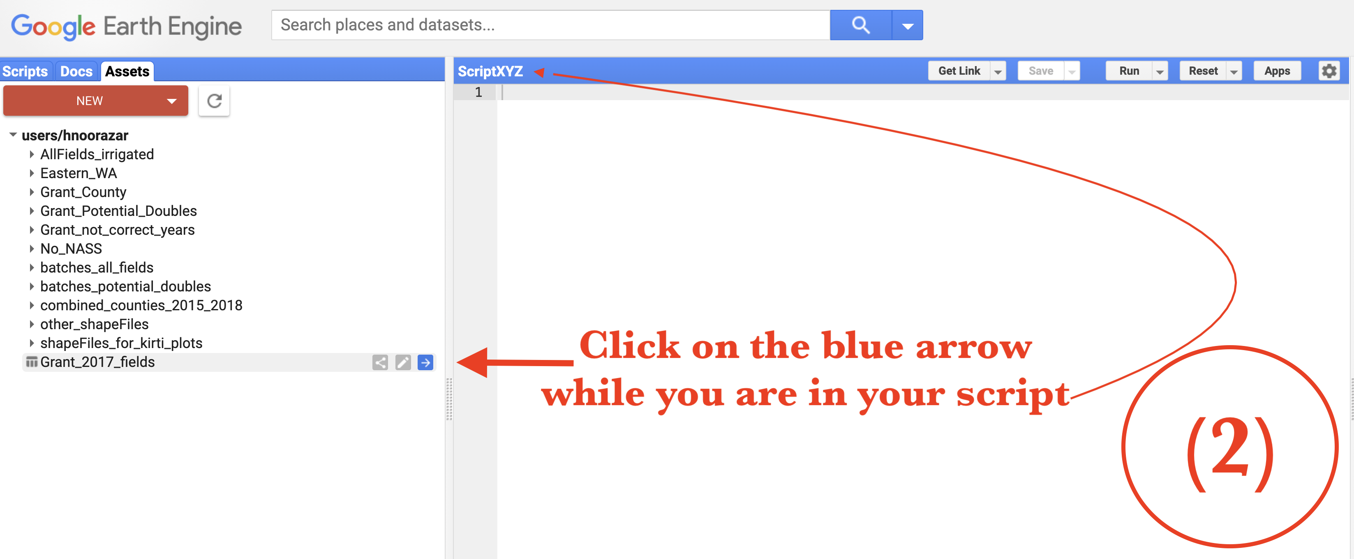
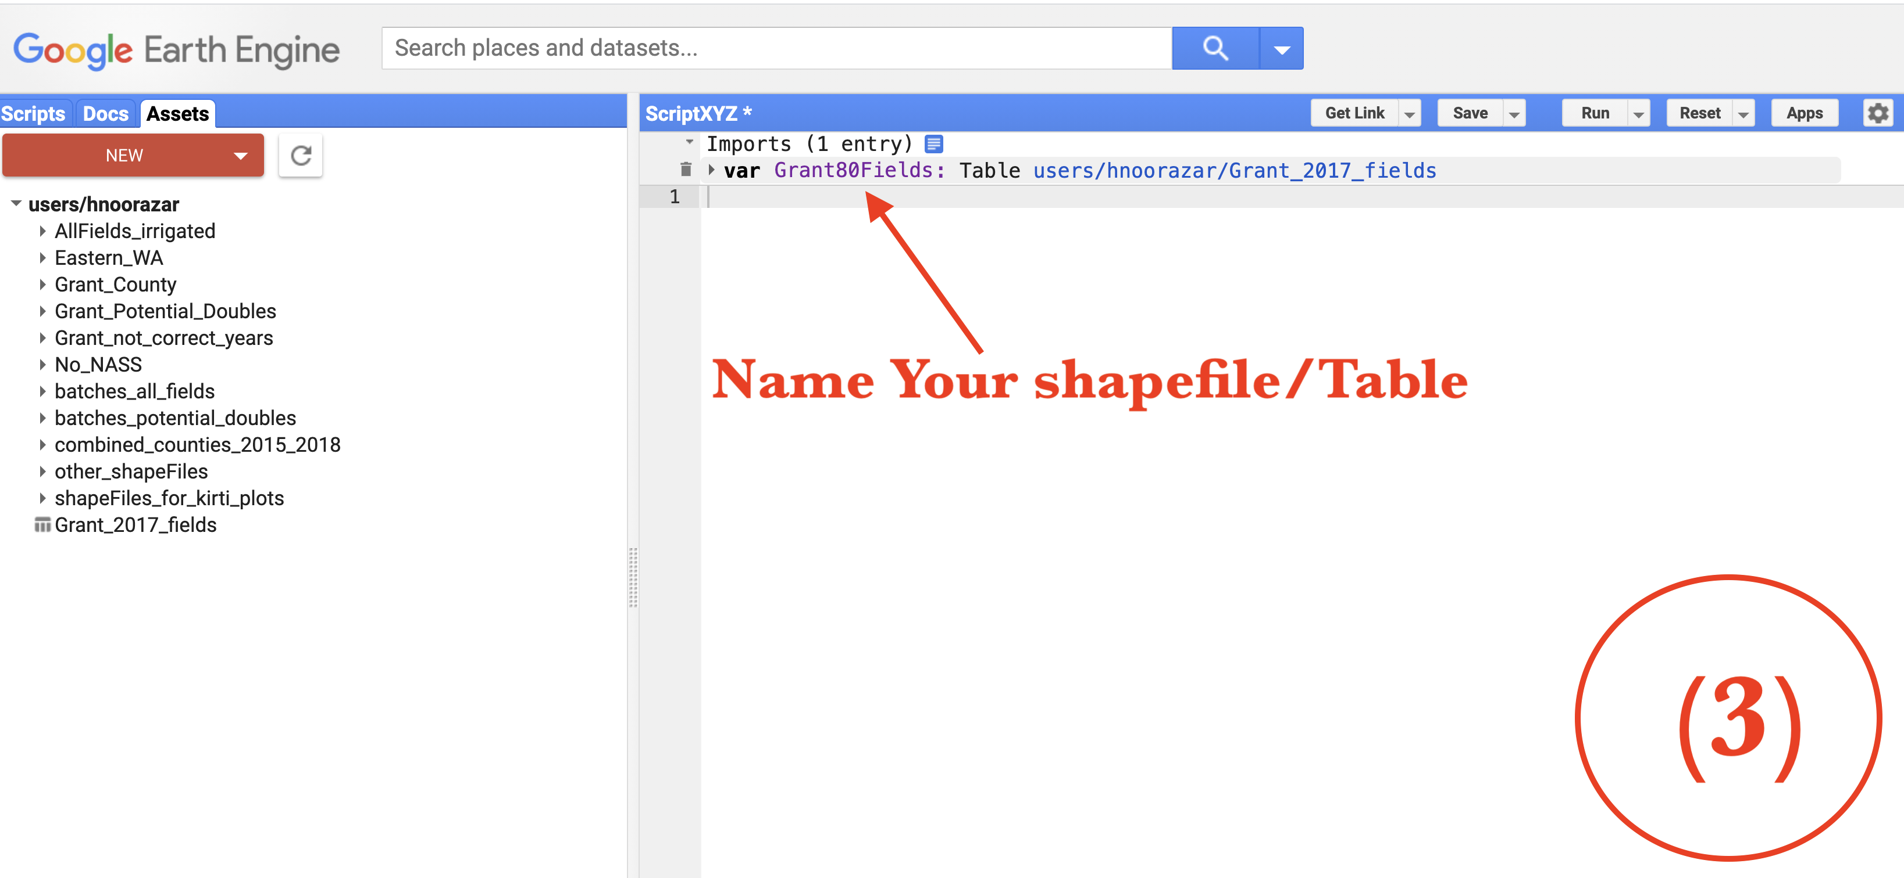
Import the shapefile
(1) Create a new Scrip (call it whatever you want). ScriptXYZ. Click on your script.
(2) Then click on Assests tab.
Then import your shapefile into your Script.
(3) Rename the shapefile you just imported.

Slide 5
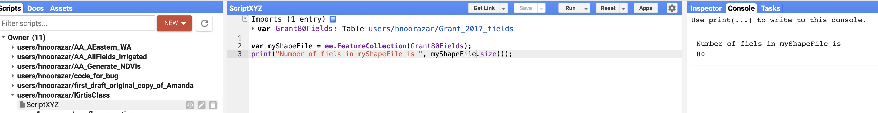
Call and use the shapefile
Now you can call the imported shapefile:
Define a new variable and assign the shapefile to it:
var myShapeFile = ee.FeatureCollection(Grant80Fields);
Now you can check the size of shapefile:
print("Number of fiels in myShapeFile is ", myShapeFile.size());

Slide 6
See Github link below for sample code
There are two JS codes on github for you:
https://github.com/HNoorazar/KC/tree/main
1. onePolyPerNode.js: This file sends each polygon to different computers on GEE and then assembles them together and writes the result into your google drive.
2. Class_allWA.js: This file divides WA into two piece, then reads everything in them, then clips the images. I.e. uses the shapefile as a mask to extract the fields in the shapefile.
The first code is supposed to send each polygon to different computers on GEE, but for some reason (unknown to me) it takes a long time for it to run if you have thousands of fields. So, use Class_allWA.js if you have too many fields.

Slide 7
VI Time-Series processing
Why do we need to process the data?
1. NDVI is suppressed by bad climatic conditions.
2. Due to bad conditions (weather or else) some of the NDVI values in the data are missed. We need, however, all of our time-series associated with different fields to be of the same lengths.
For reasons mentioned above we need to process the data to reduce the noise and make them to be of the same length.

Slide 8
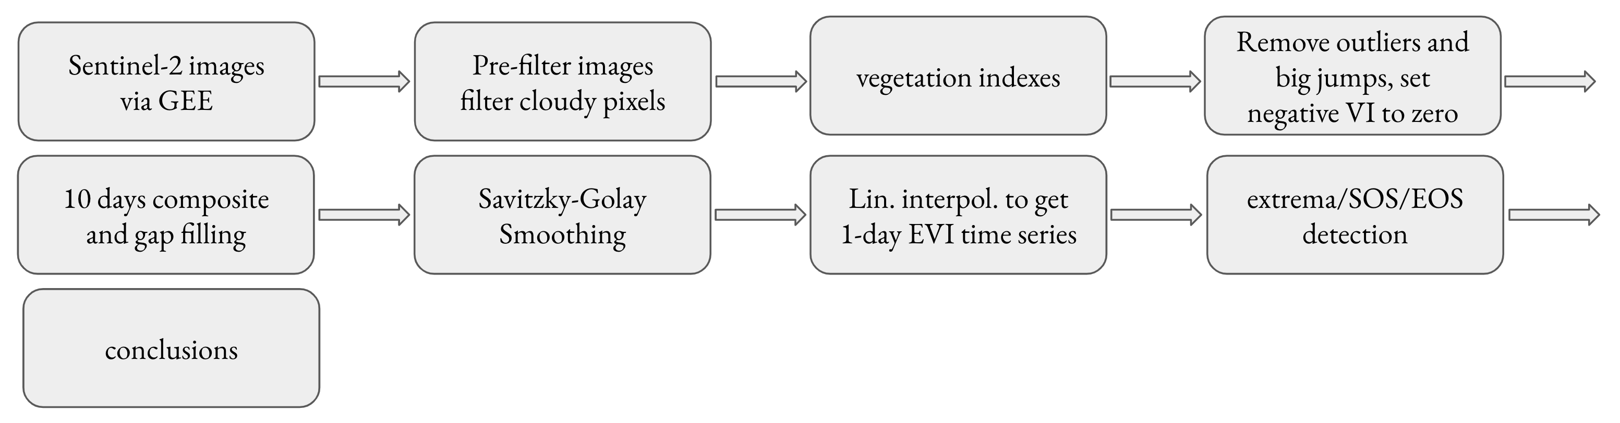
My Algorithm
The algorithm is given below. The cloud filtering steps are done on GEE.

Slide 9
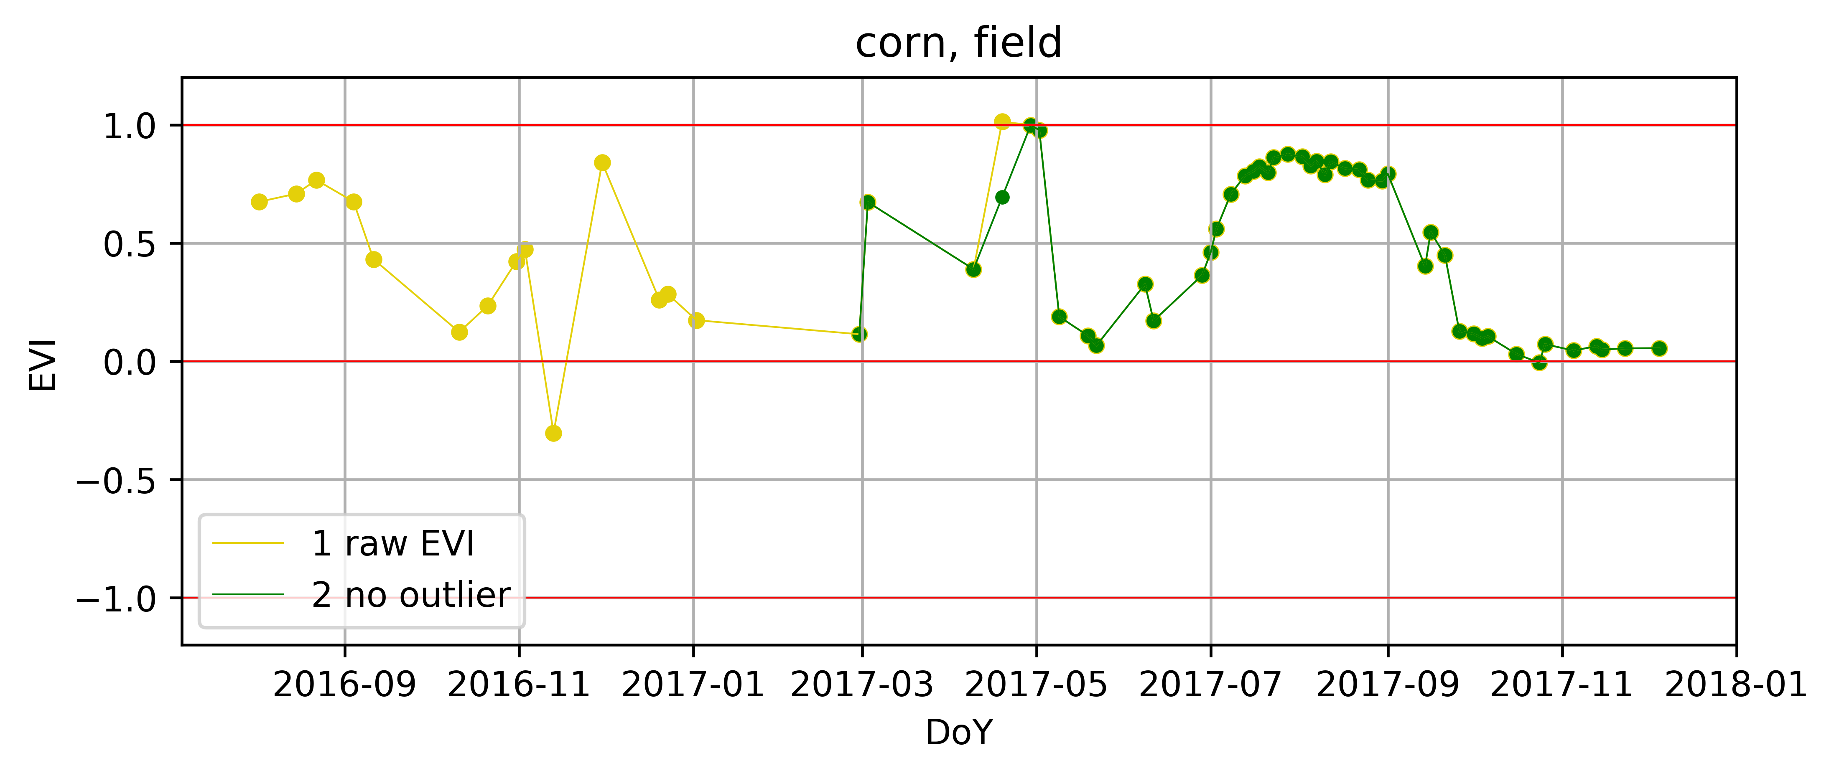
The Algorithm
1. Remove outliers and big jumps.

Slide 10
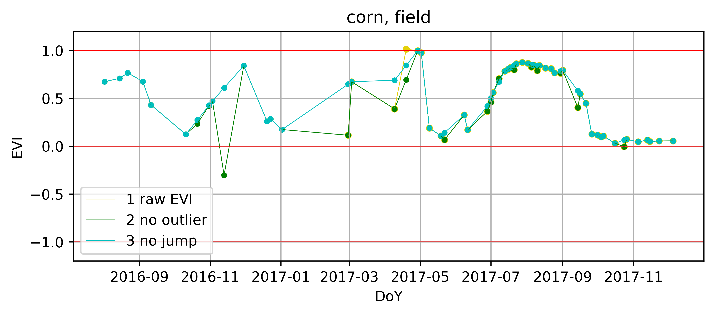
The algorithm
Remove Big jumps

Slide 11
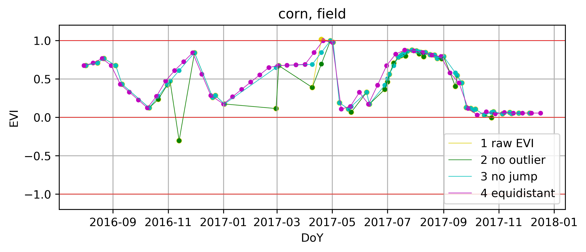
The Algorithm
10-days composite and fill the gaps.

Slide 12
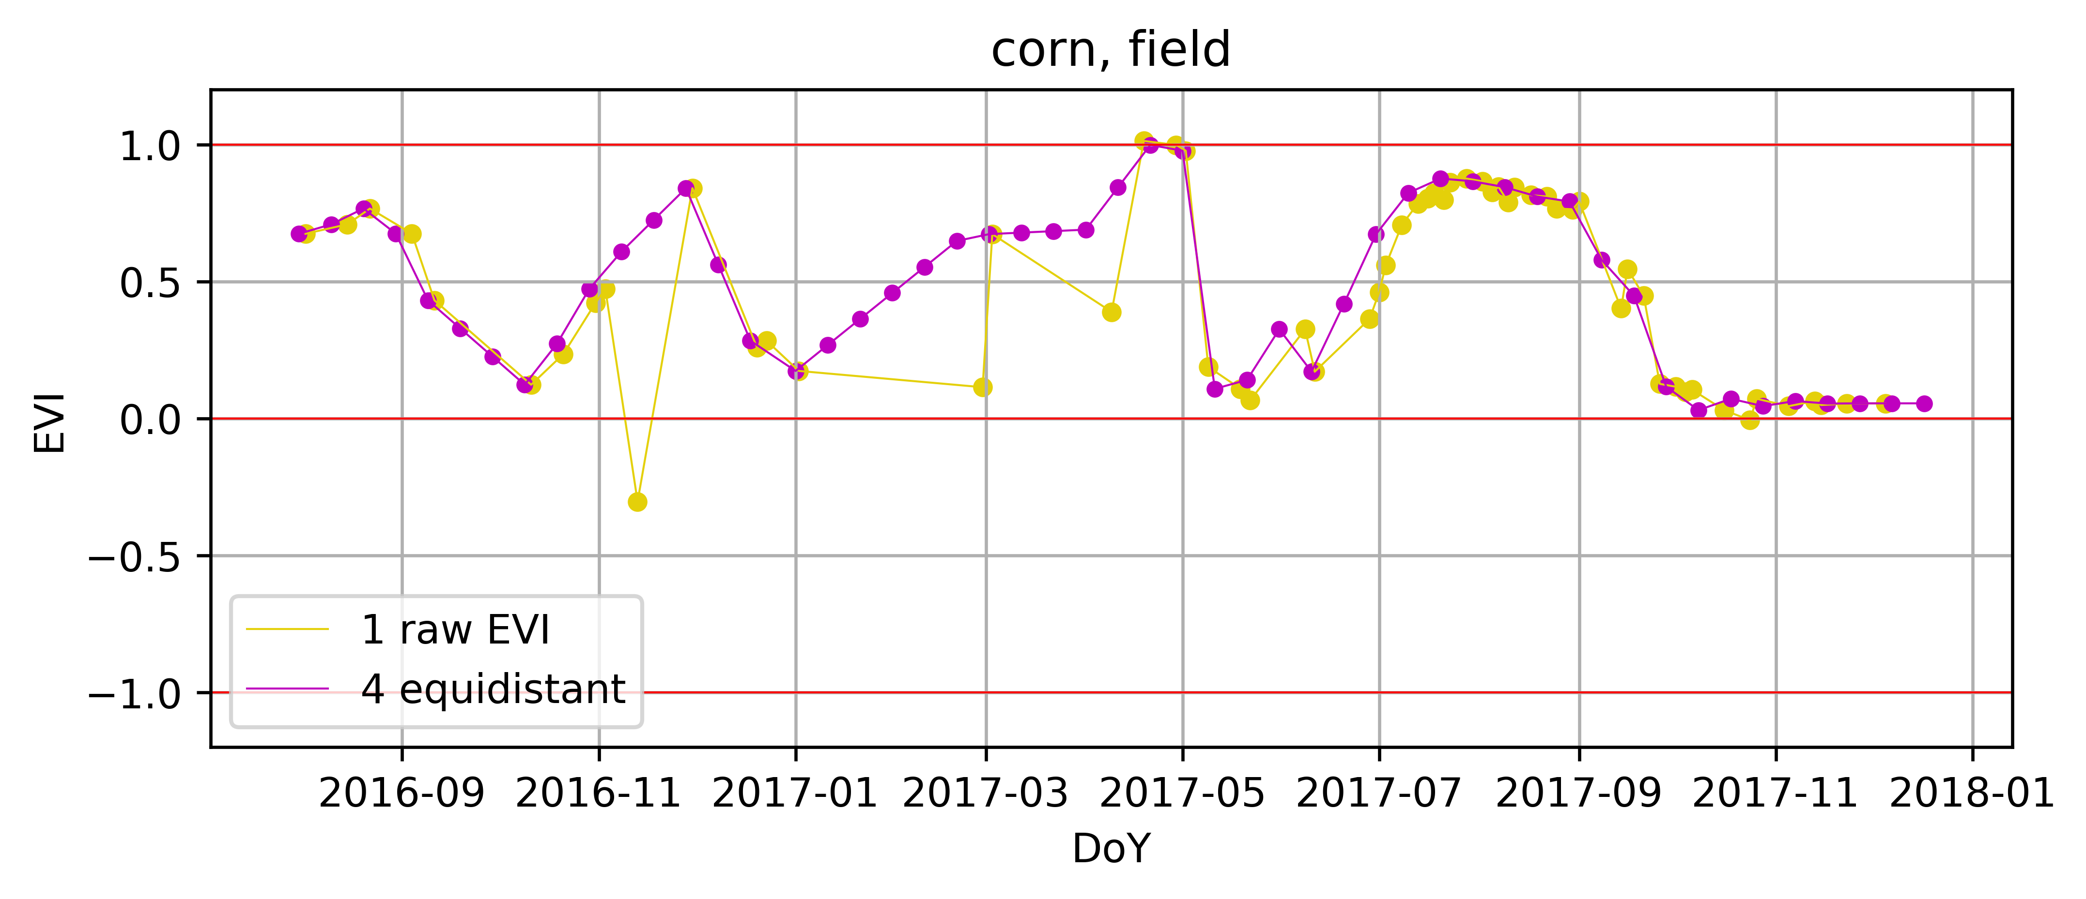
The algorithm
Recap. (remove outliers and big jumps. Regularize. Fill the gaps.)

Slide 13
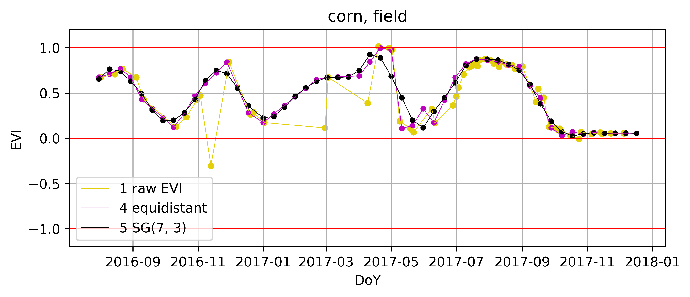
The Algorithm
Use a smoothing method (e.g. regression, spline, Savitzky-Golay) to reduce the noise even further.
SG on R: https://www.rdocumentation.org/packages/prospectr/versions/0.2.1/topics/savitzkyGolay
SG on Python: https://docs.scipy.org/doc/scipy/reference/generated/scipy.signal.savgol_filter.html

Slide 14
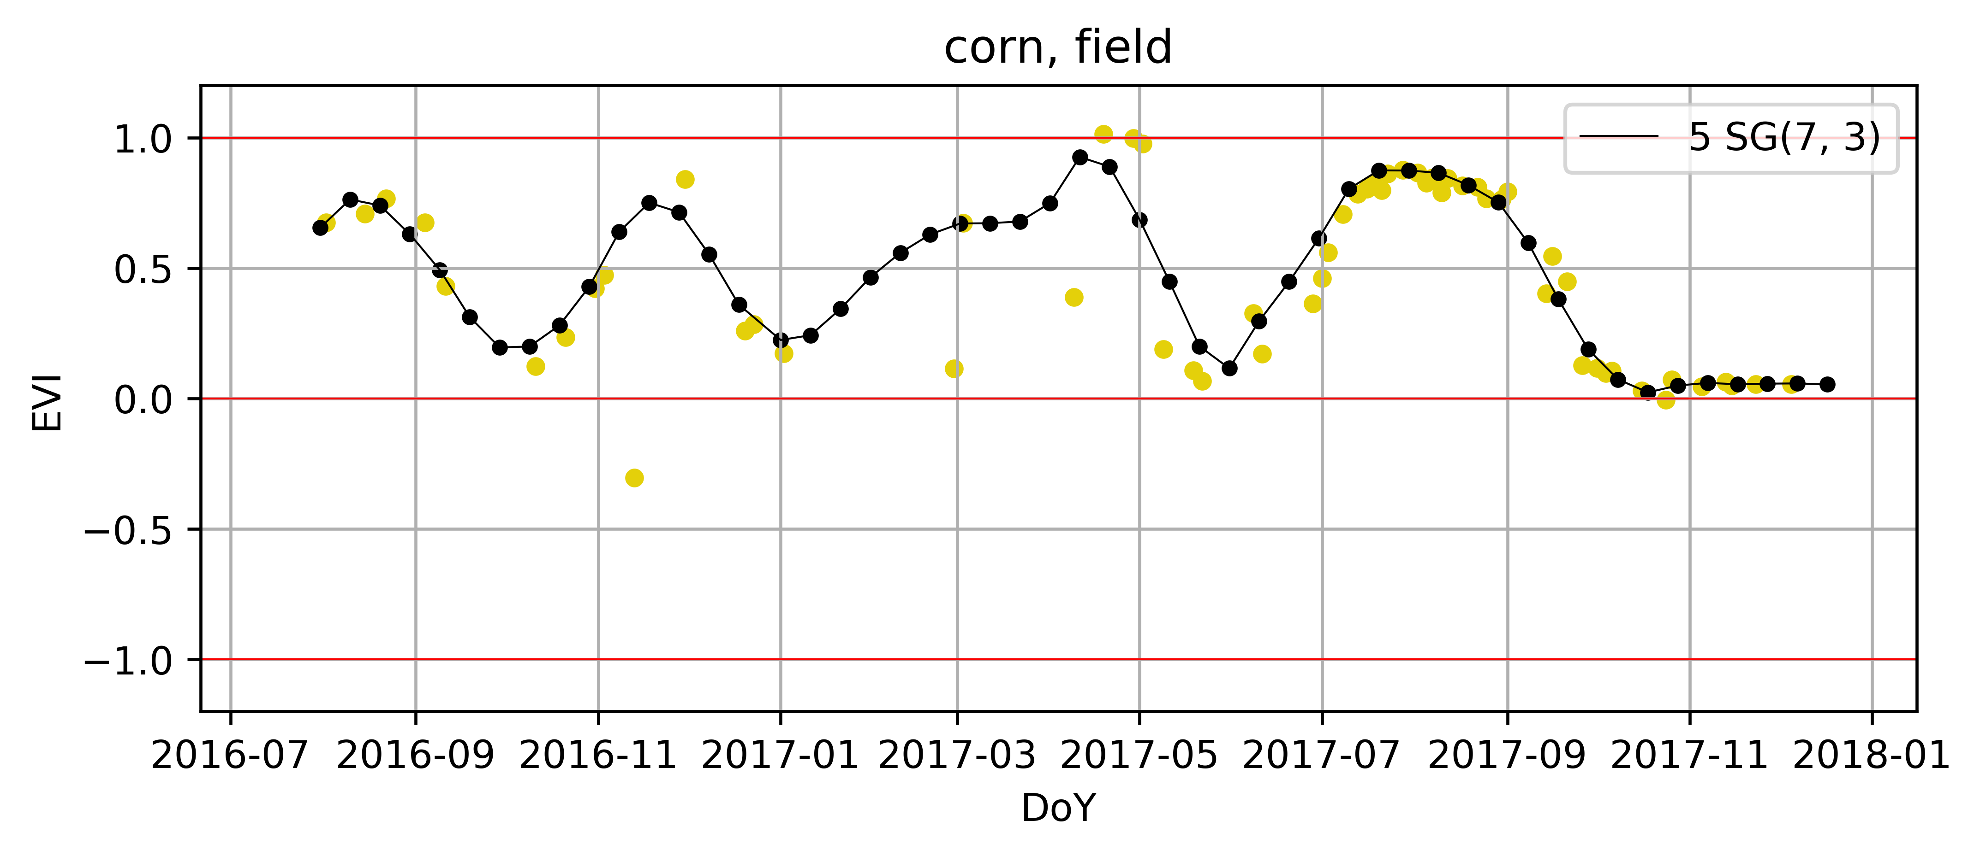
The algorithm
Final Result

Slide 15
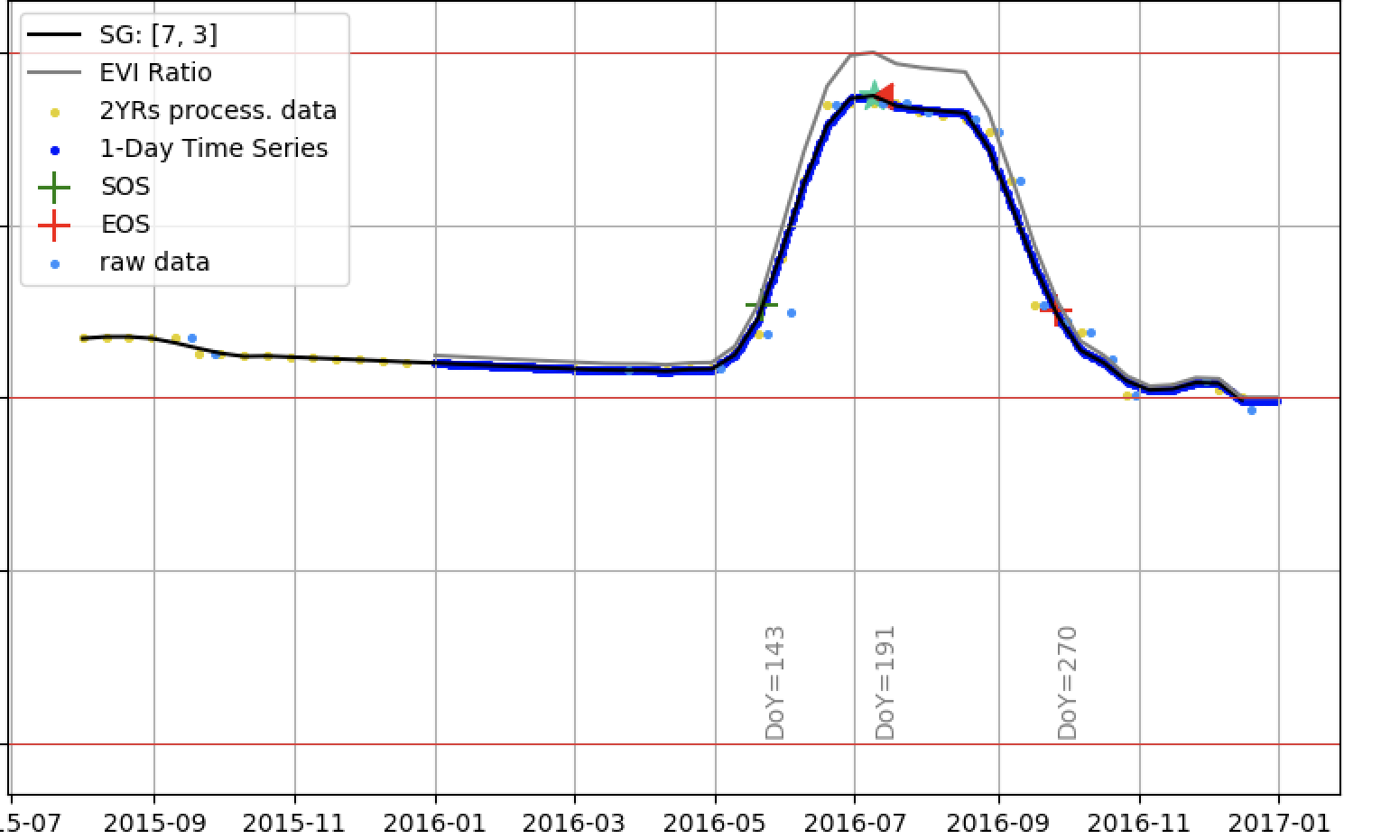
Feature Extraction
Methods for Start and ENd of season detection:
NDVI-ratio method
Threshold Method
The method in TIMESAT software
?

Slide 16
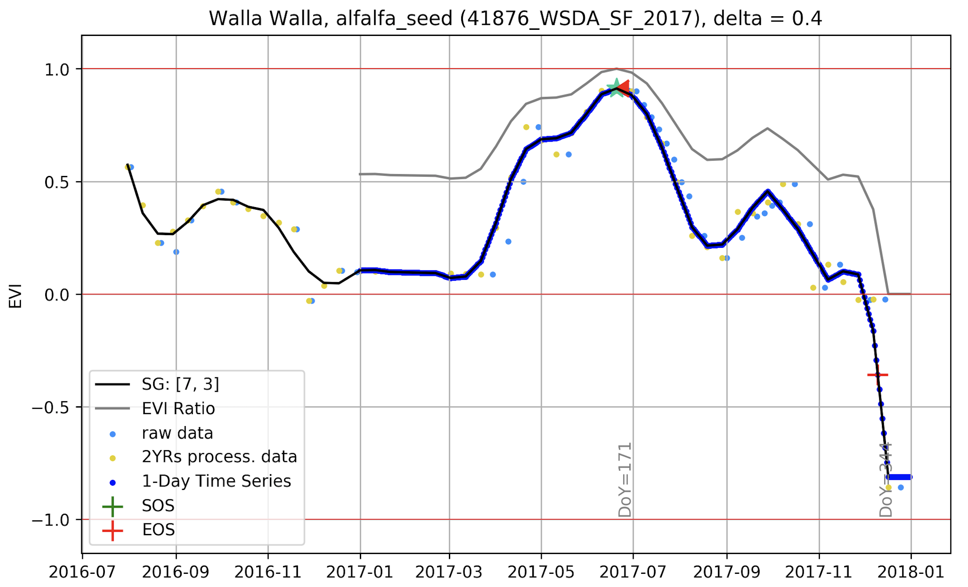
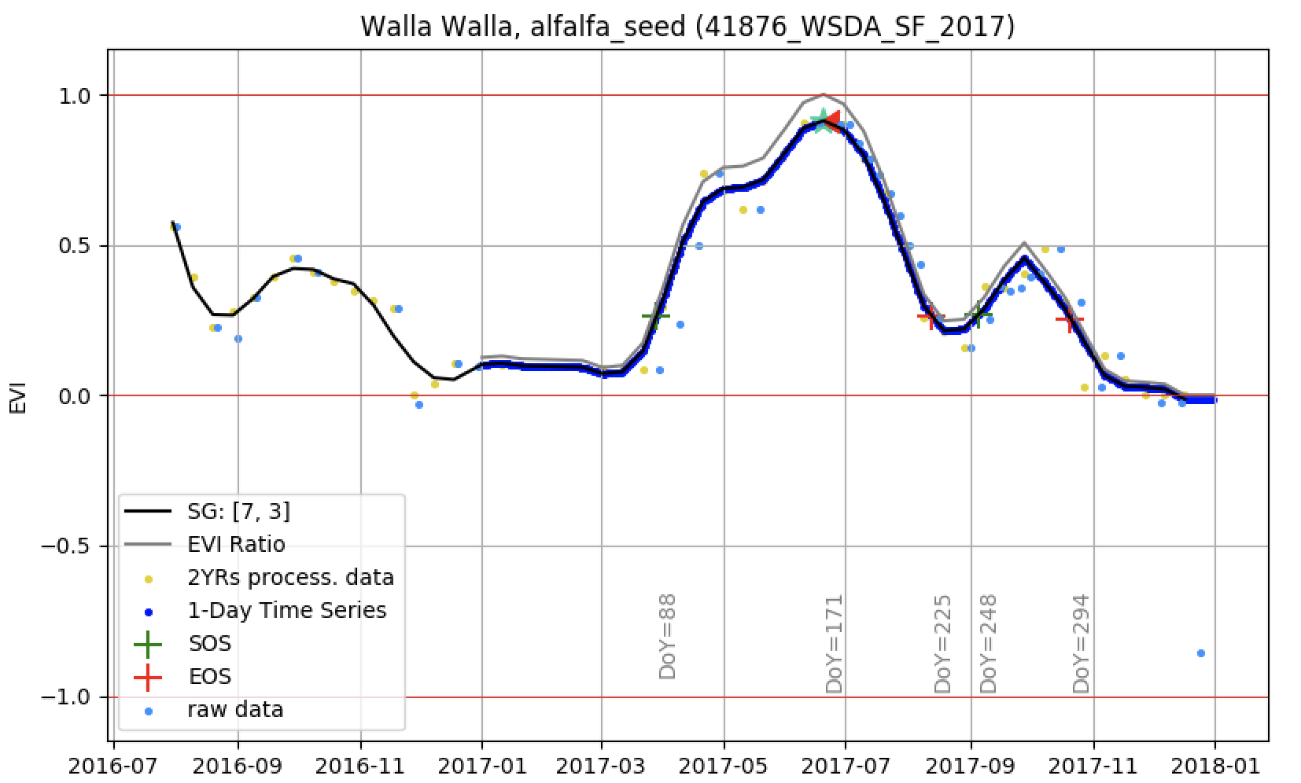
Why did I set negative NDVI/EVI to zero?

Slide 17
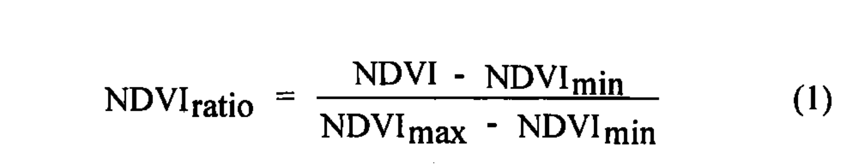
NDVI-Ratio Method
A CONTINENTAL PHENOLOGY MODEL FOR MONITORING VEGETATION RESPONSES TO INTERANNUAL CLIMATIC VARIABILITY
BY WHITE, THORNTON, AND RUNNING.

